Slide 1
Understanding Customer Loyalty in the Brazilian Economy
Darshan Patel
Fordham University Gabelli School of Business
Spring 2019 – Machine learning in statistics

Slide 2
Introduction
Elo, one of the biggest debit/credit/gift card providers in brazil, wants to offer personalized promotions to card holders based on their purchases
Goal: boost promotional campaign when partnering with merchants who use Elo as a card provider by predicting a loyalty score per card holder
A Kaggle competition

Slide 3
Data
Training set: 201,917 unique card holders – first active month, card ID, feature 1, feature 2, feature 3, loyalty score
Testing set: 123, 623 unique card holders – first active month, card ID, feature 1, feature 2, feature 3 (loyalty score not provided)
Historical Transactions – 29,112,361 records of transactions from a span of 3 months - 14 variables
New Transactions – 1,963,031 records of transactions from a span of two months for merchants not mentioned in above dataset– 14 variables
Merchants – 334,696 records of different merchants’ statistics – 22 variables

Slide 4
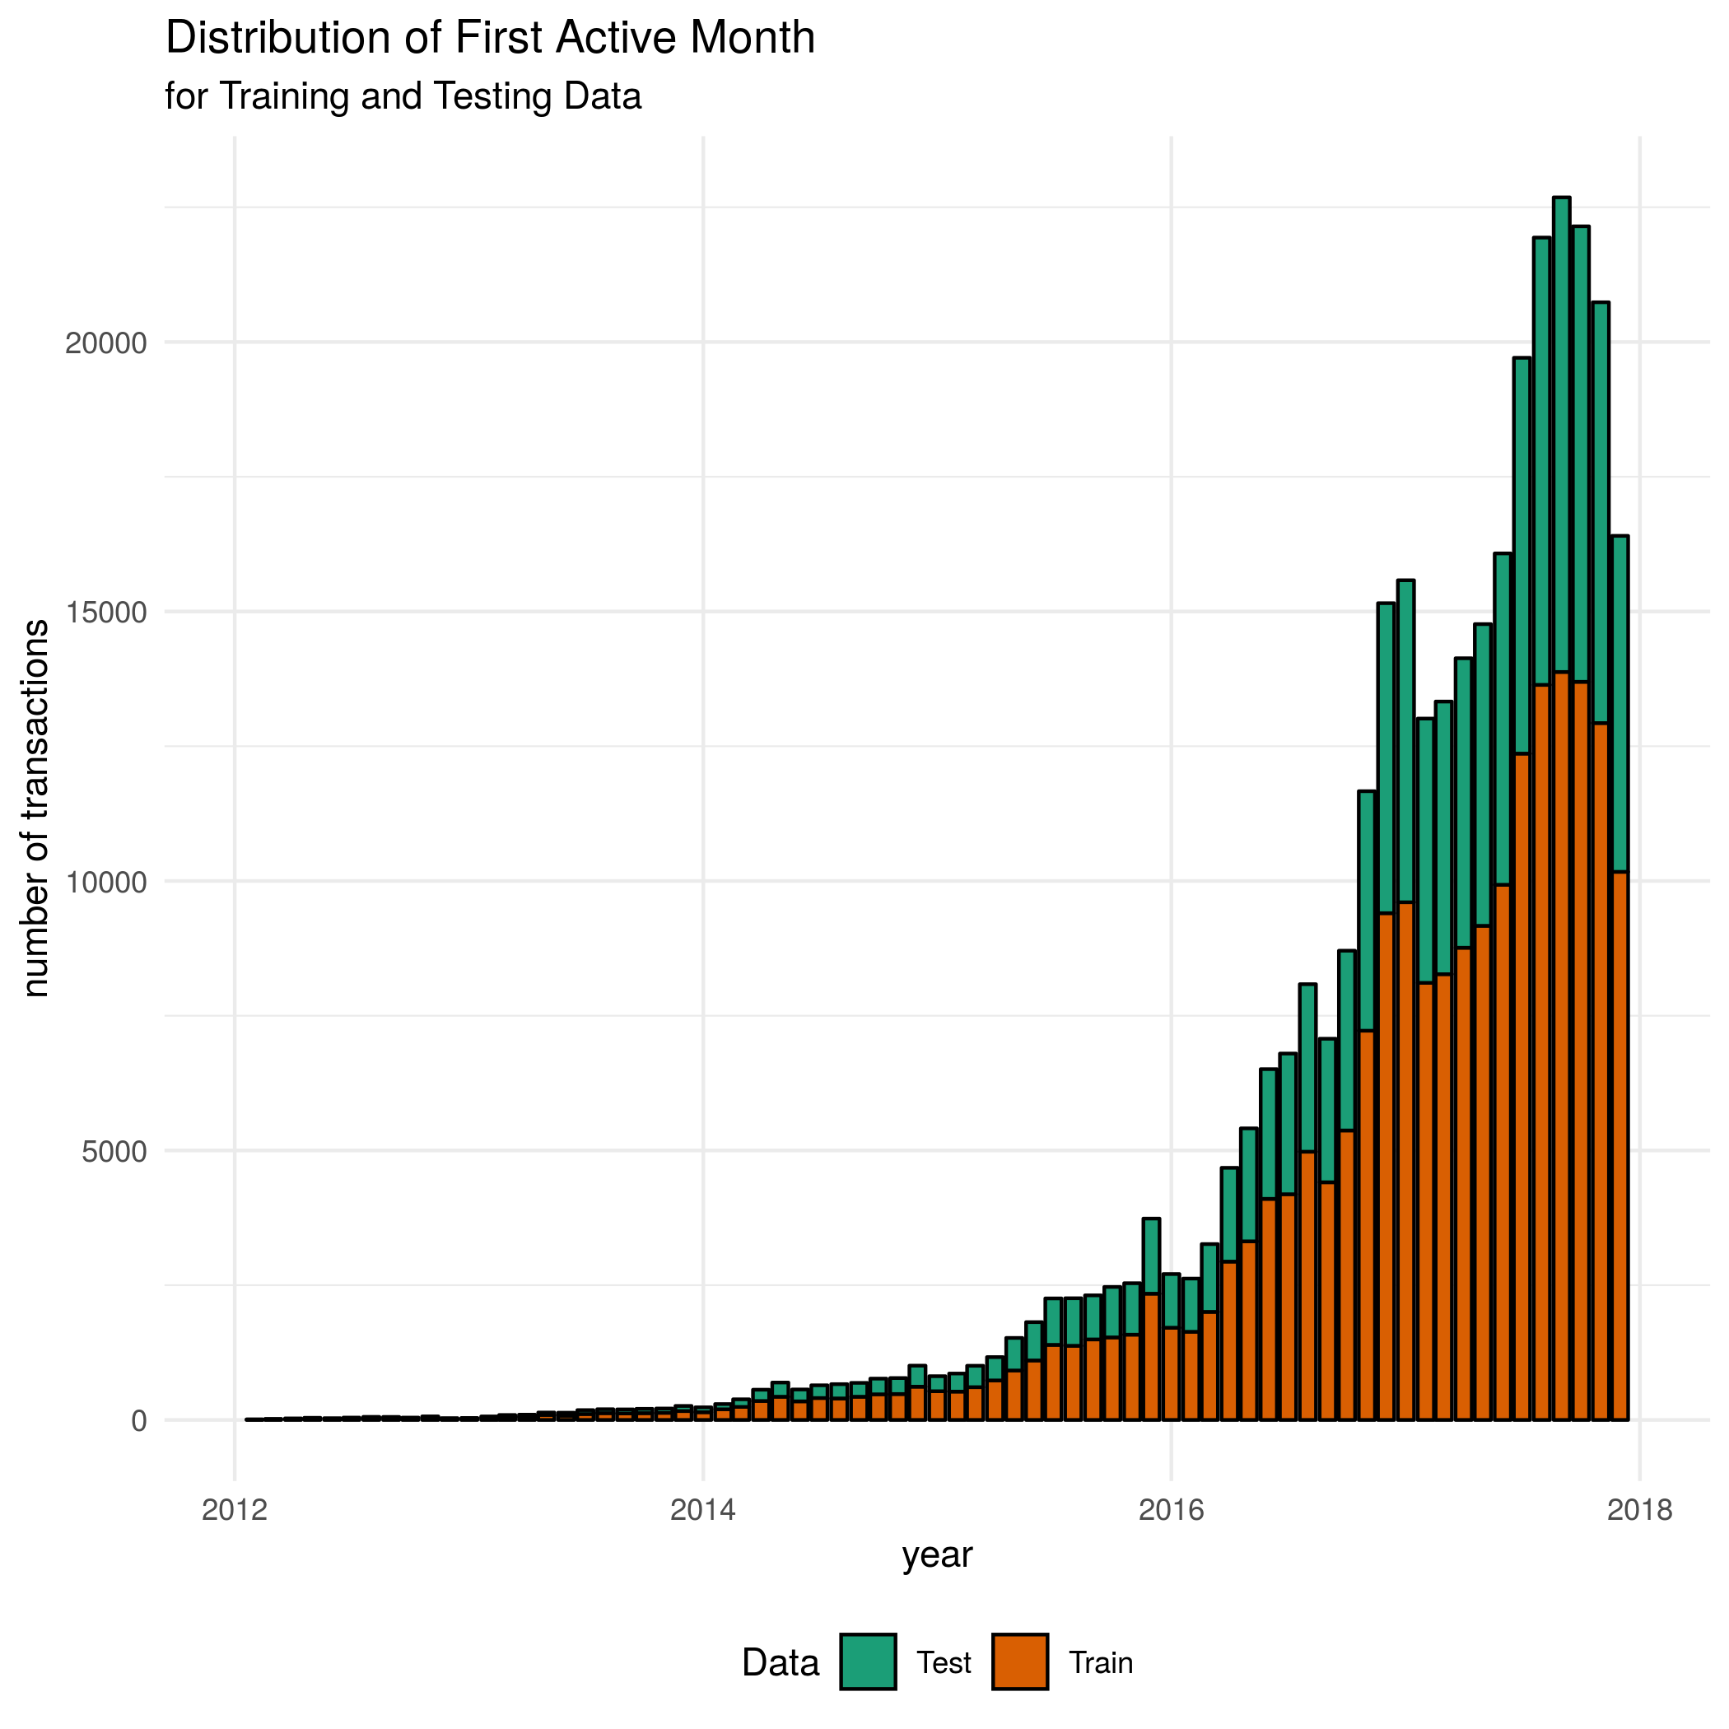
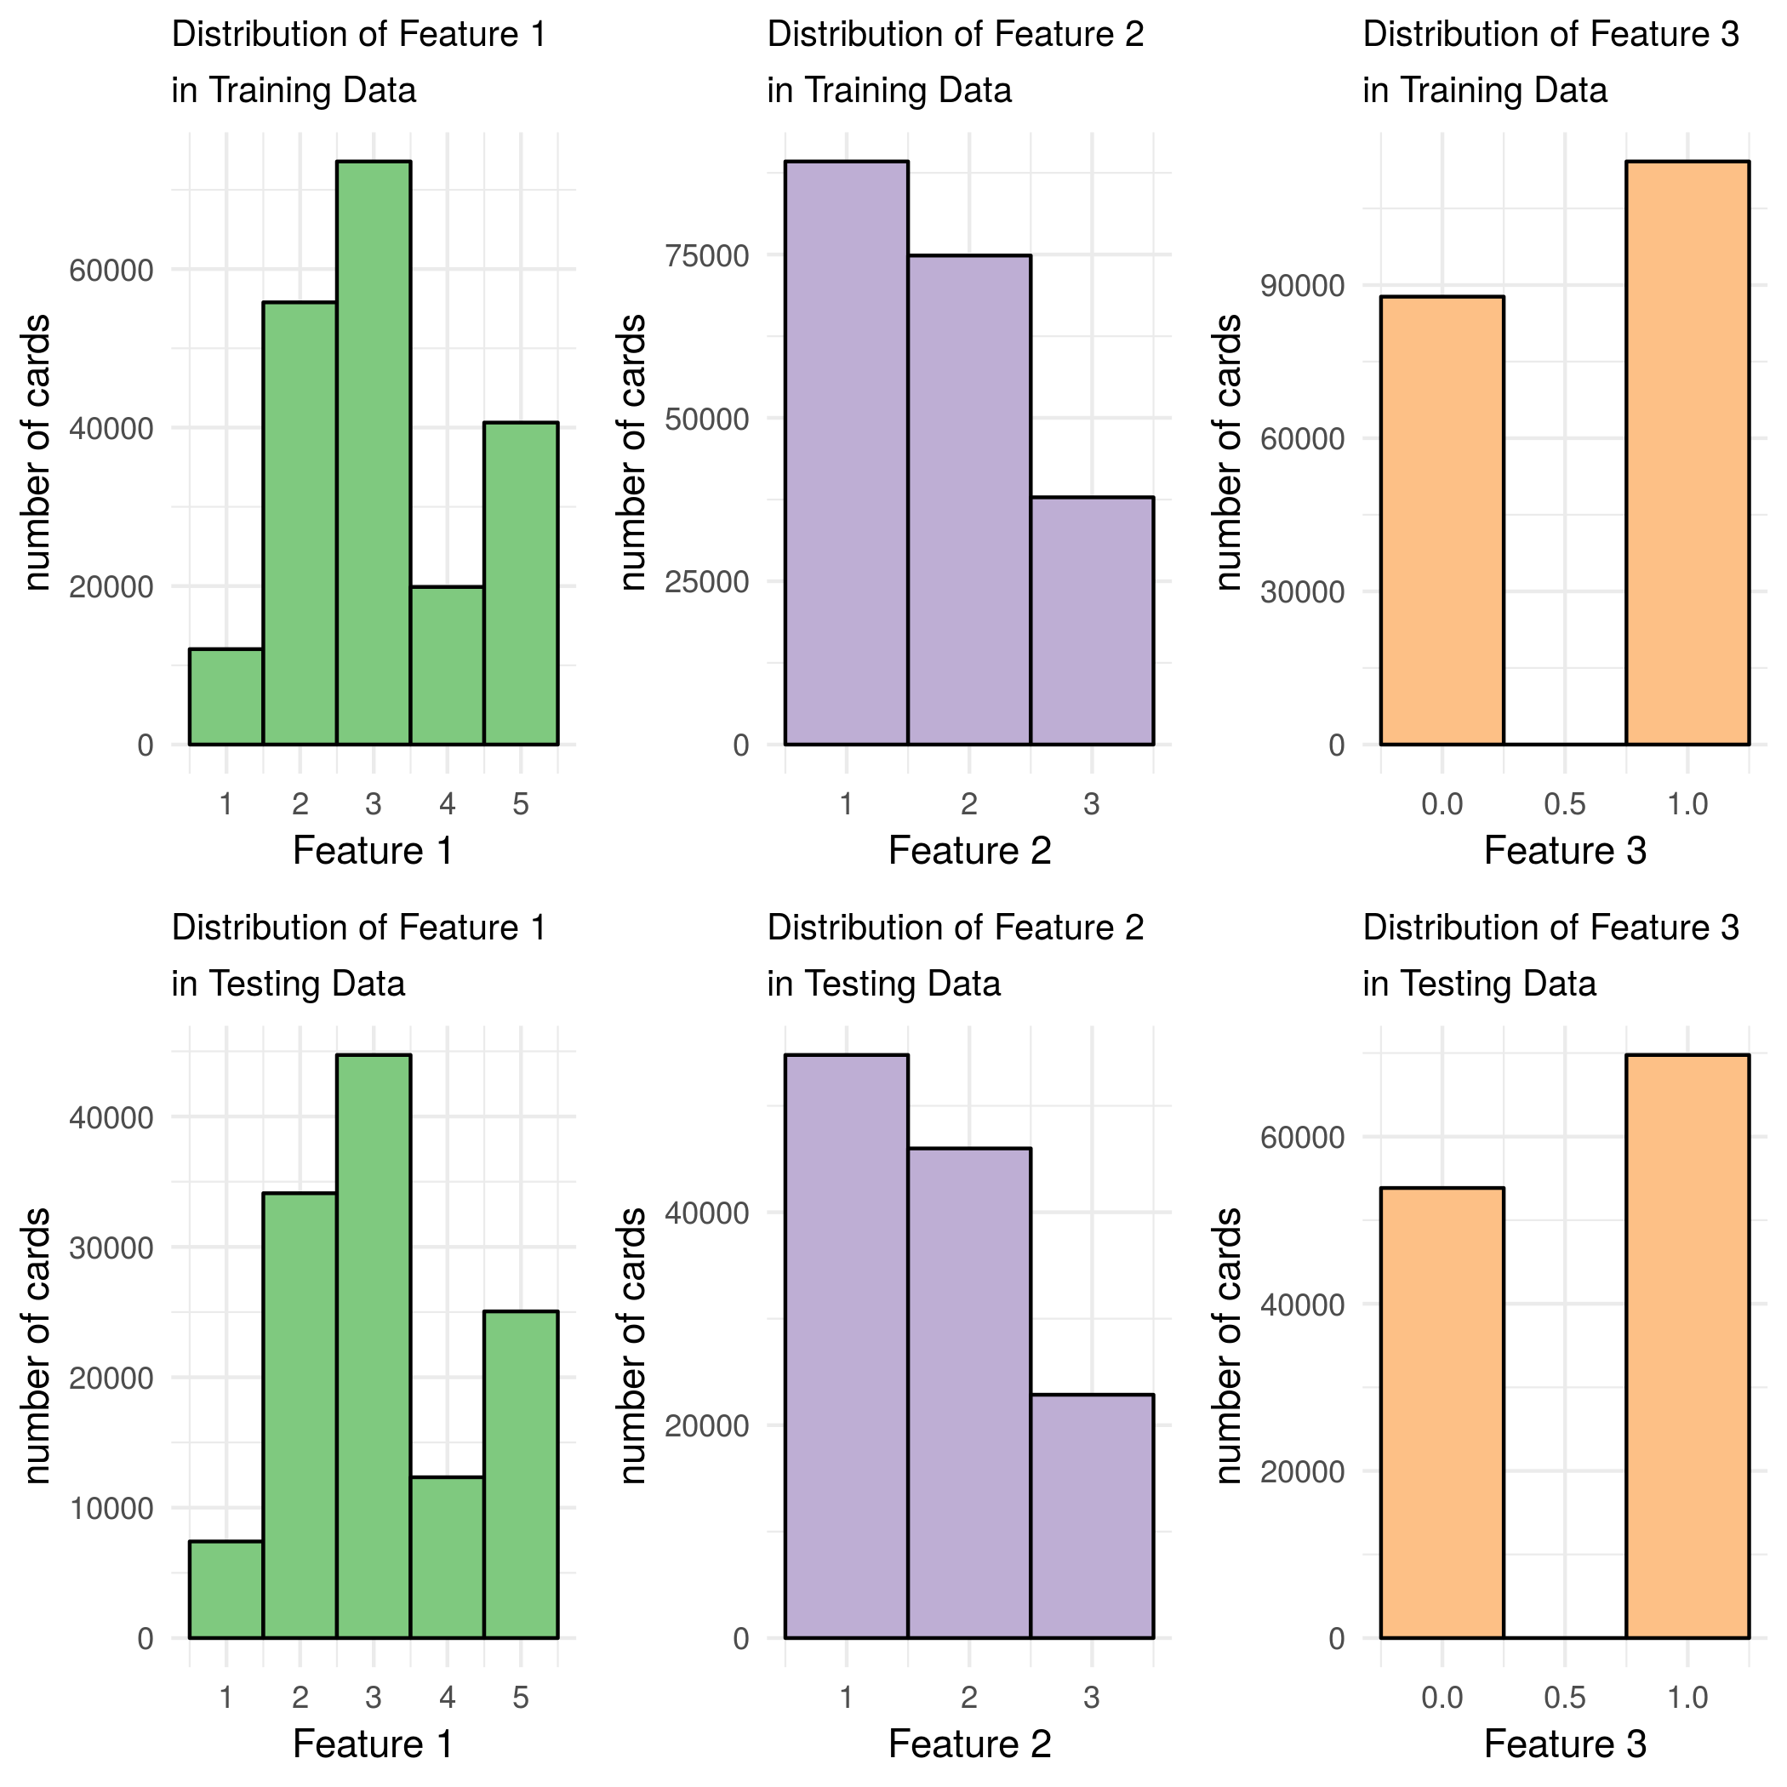
EDA- Features and First Active Month

Slide 5
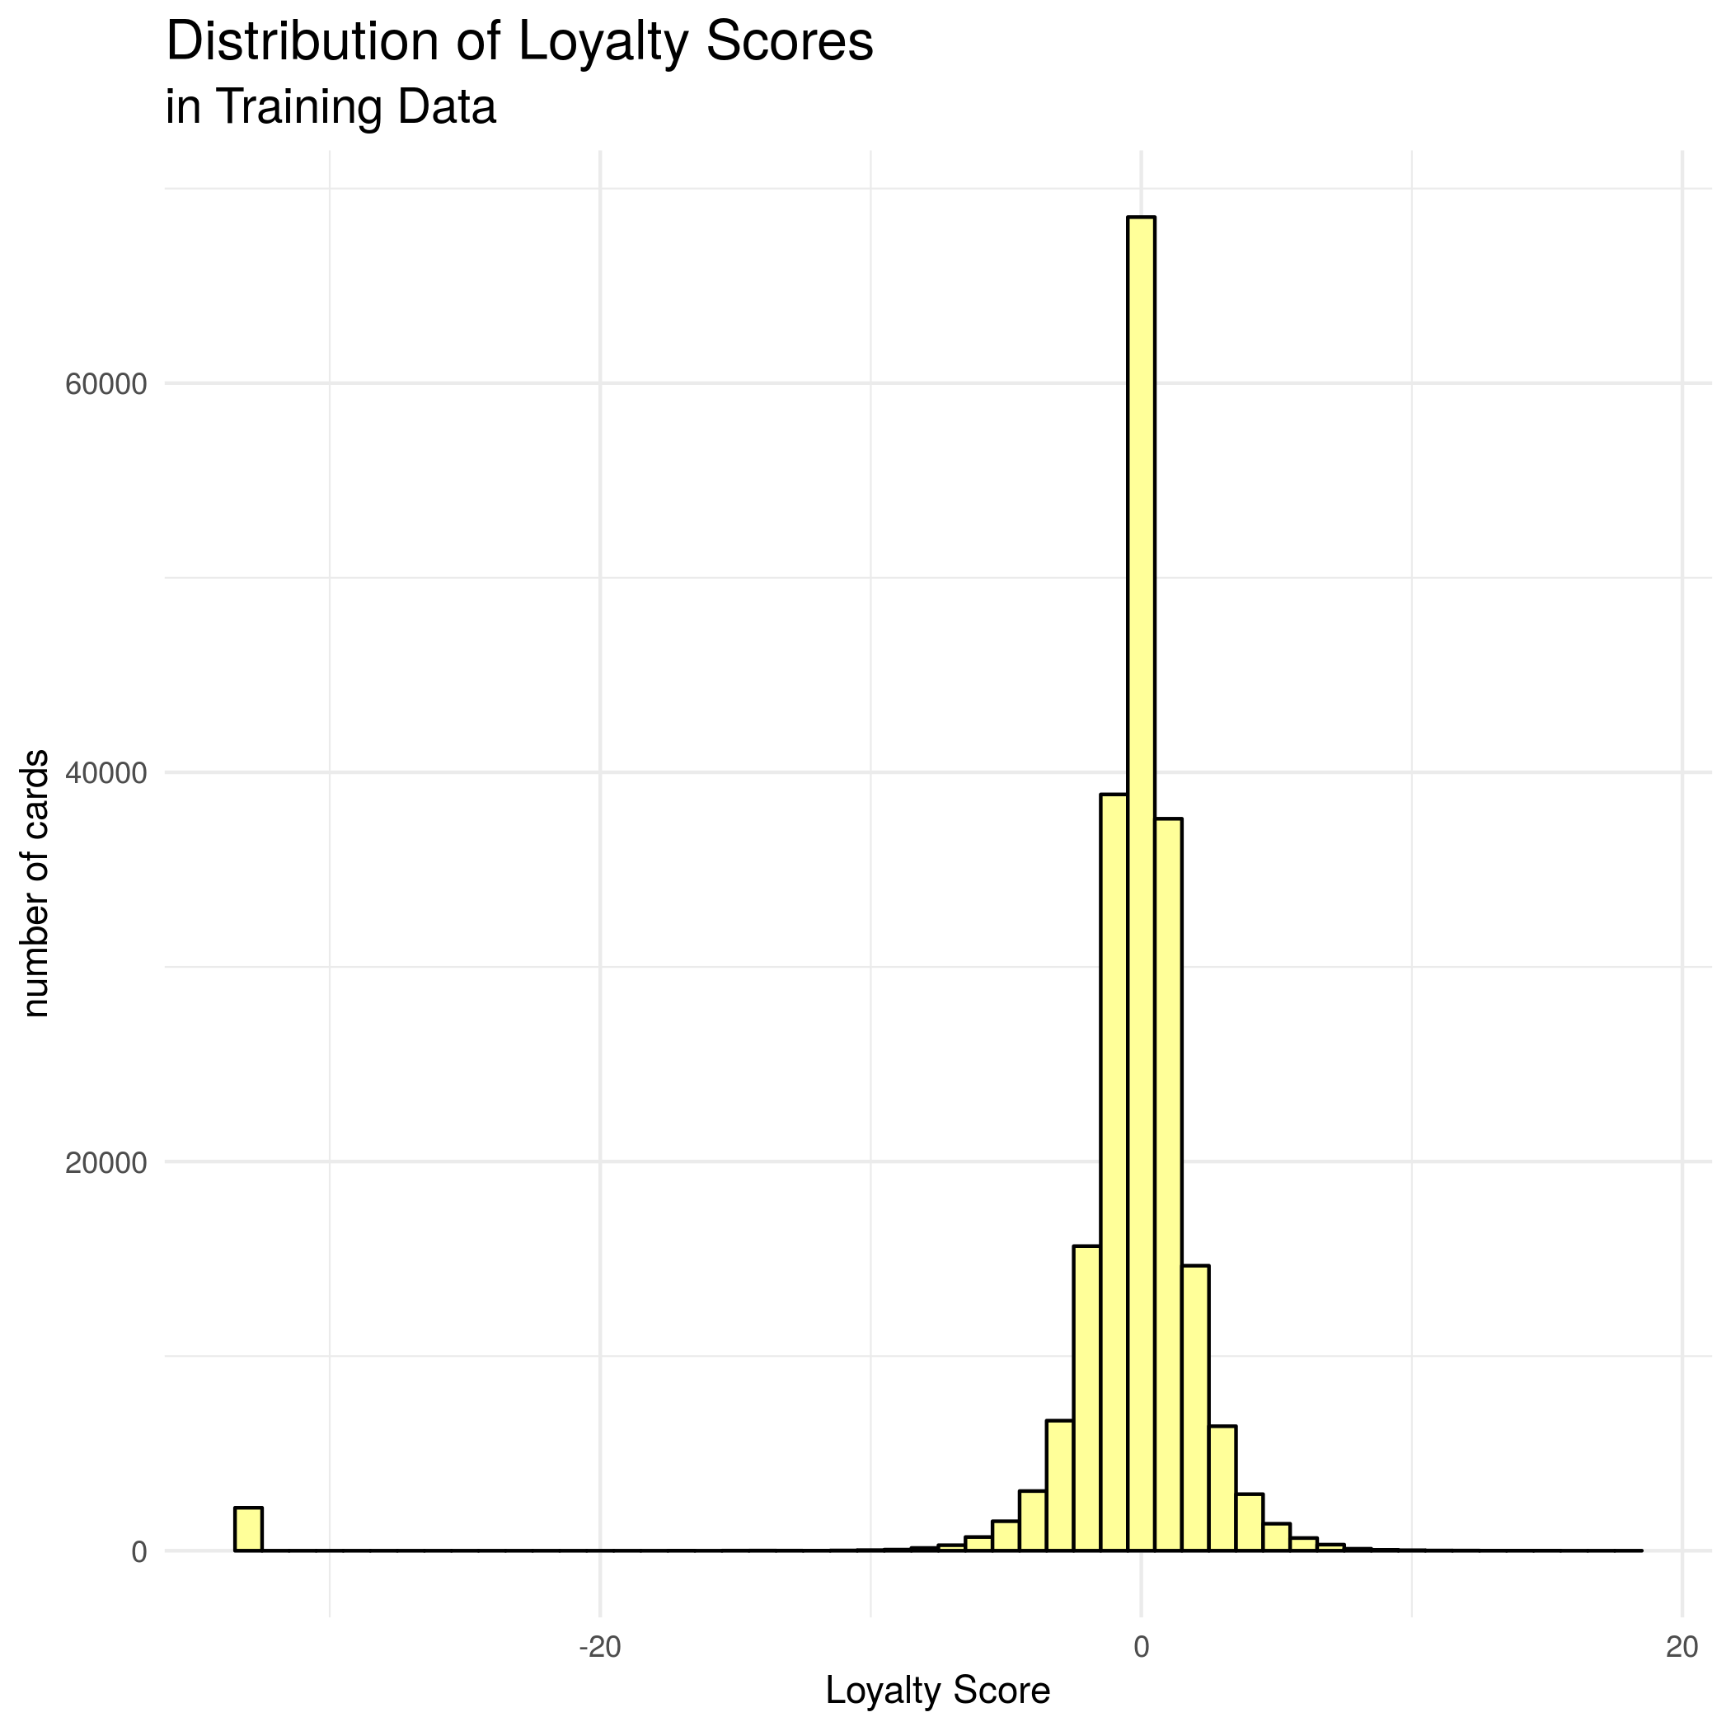
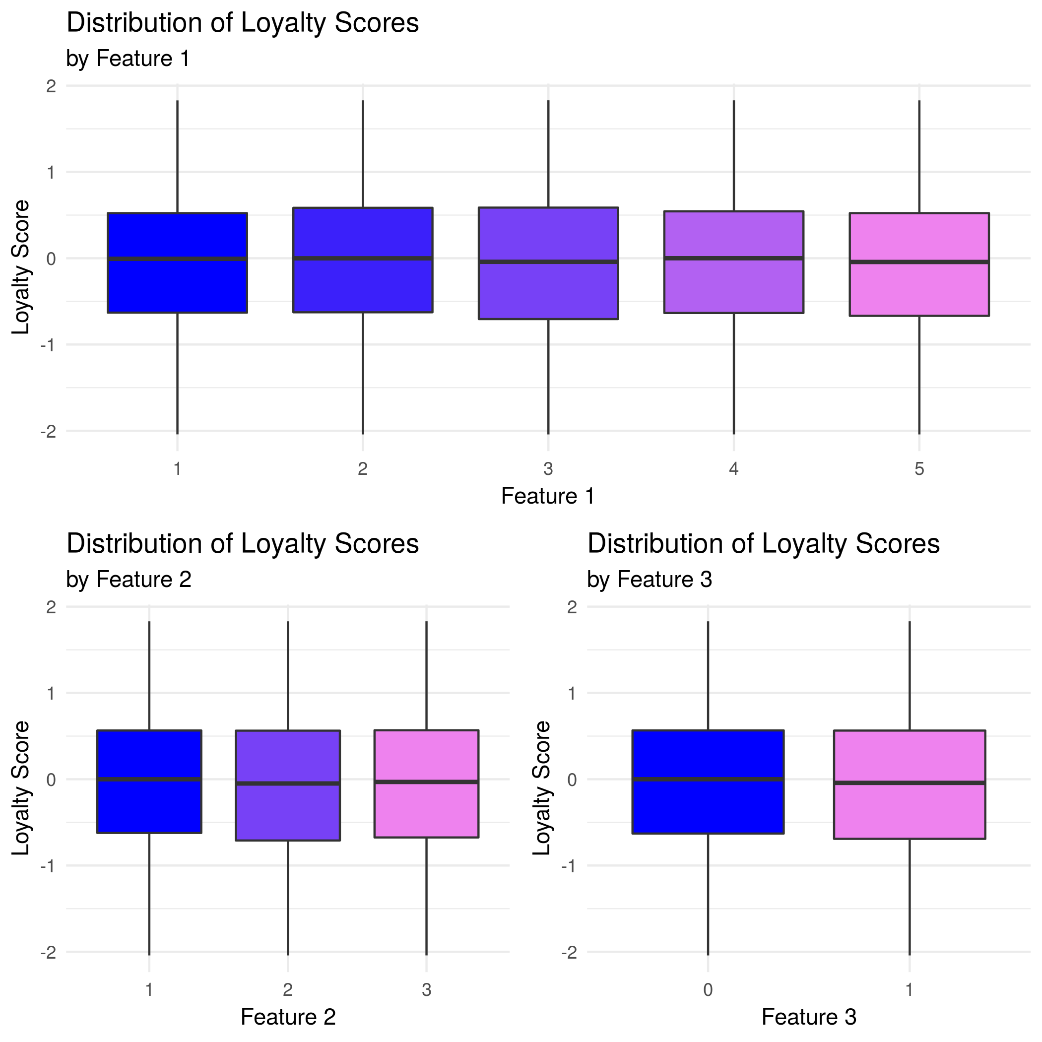
EDA – Features vs. Target

Slide 6
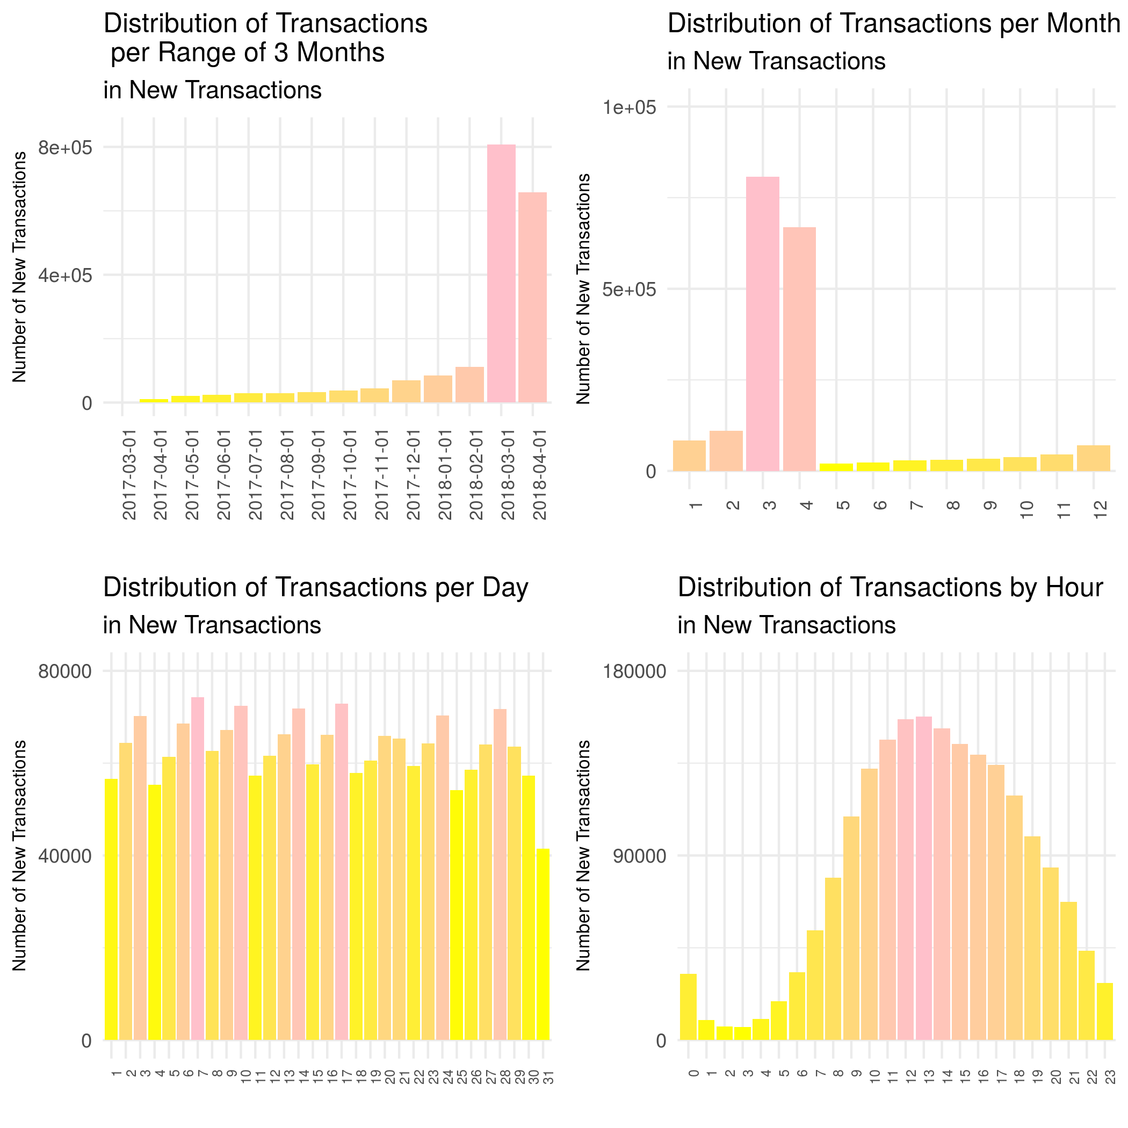
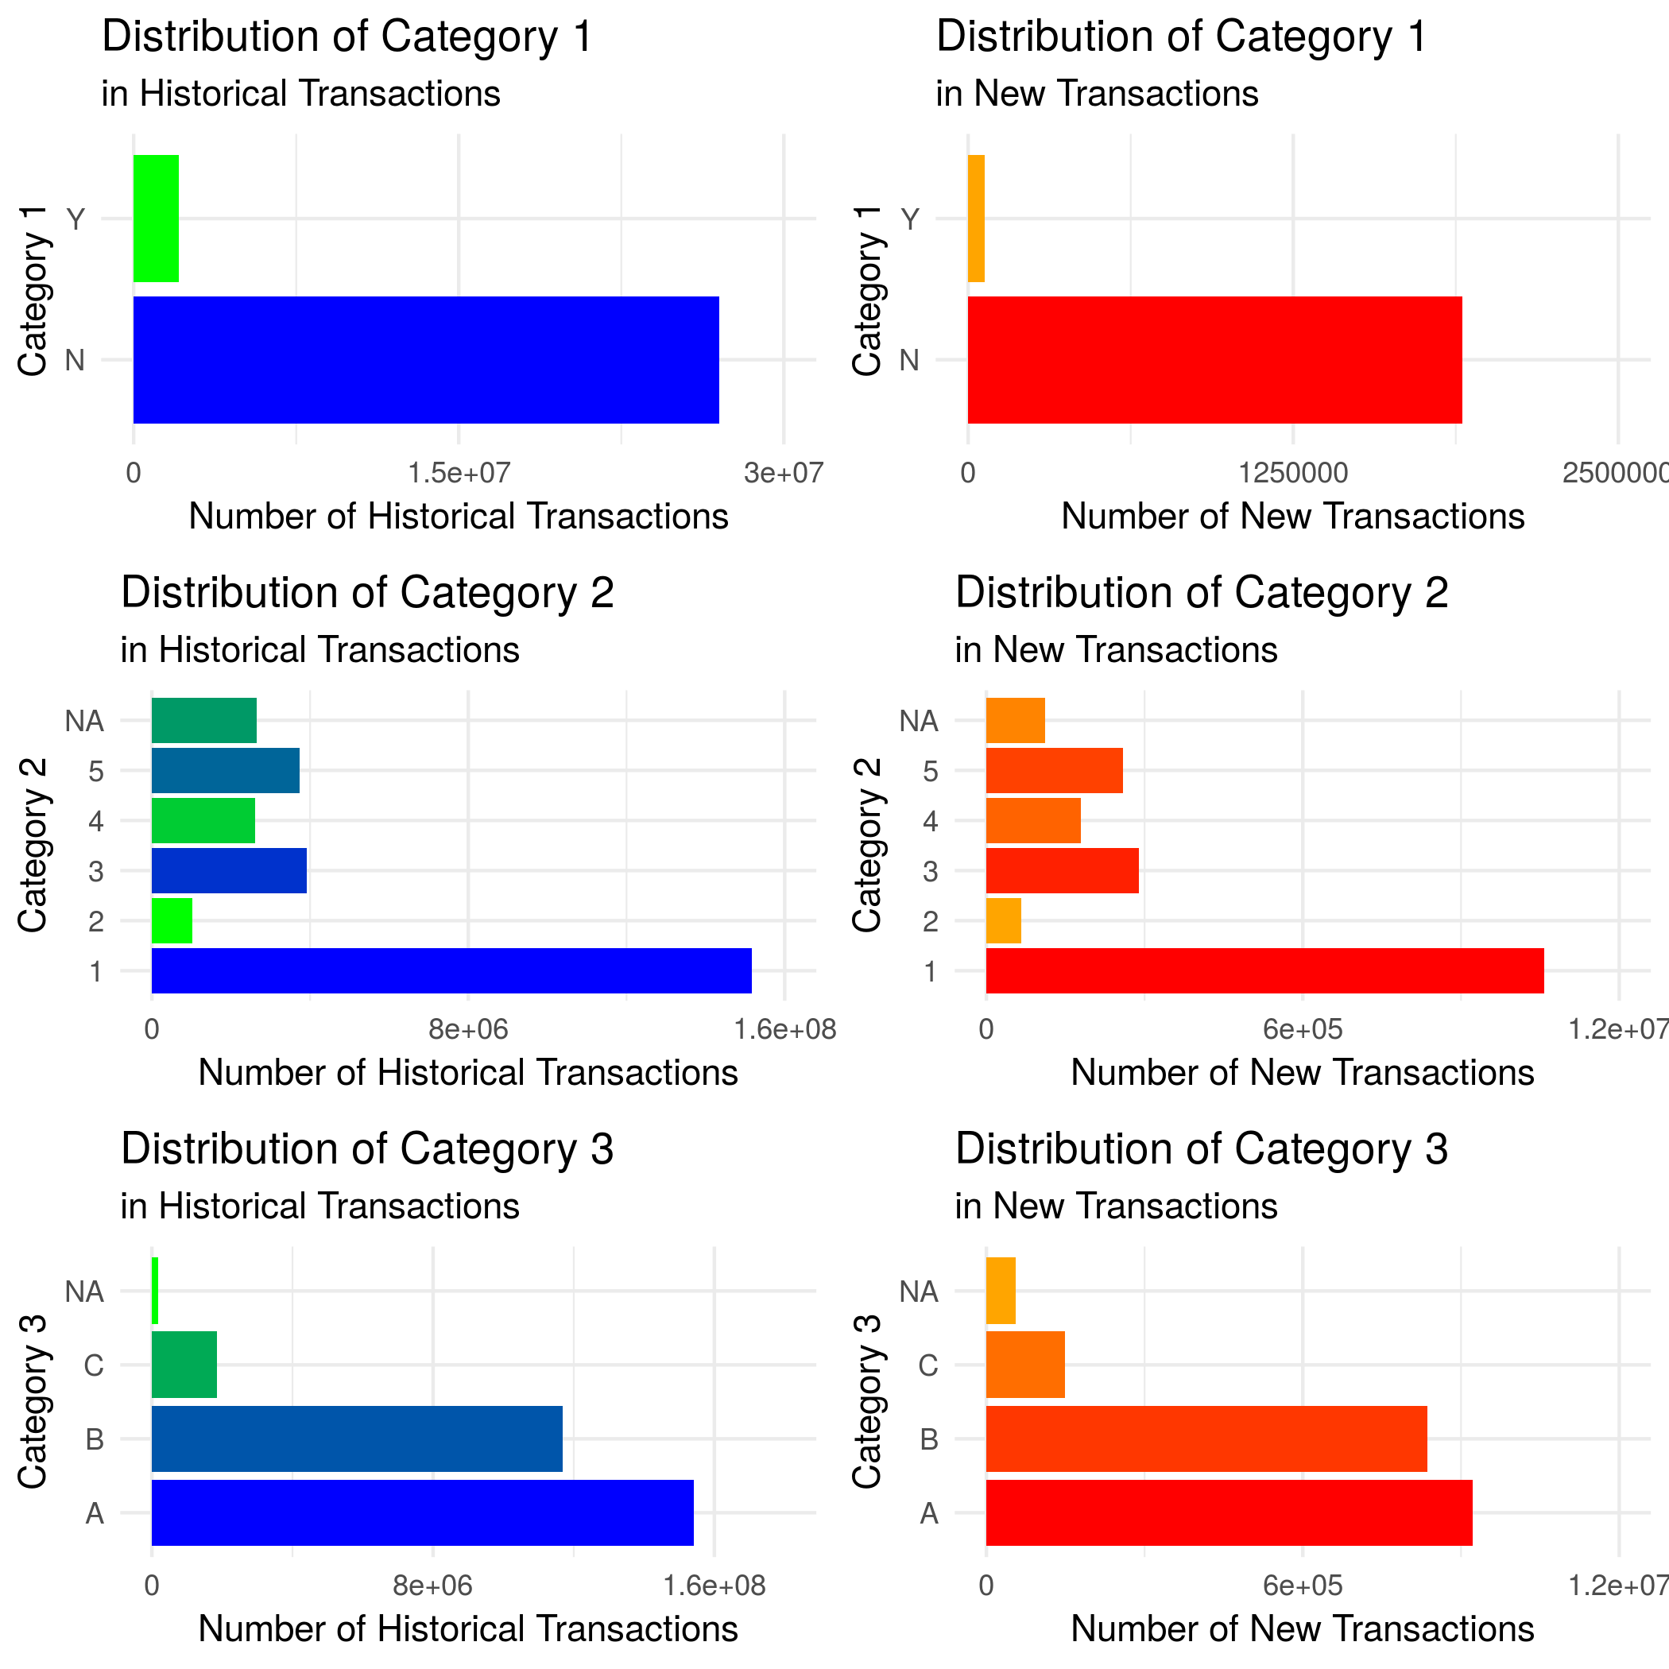
EDA - Transactions

Slide 7
Preprocessing Phase I
Replace with NA
ID values of -1, 99
transactions greater than 12 (one year),
normalized purchase amount greater than 1
Aggregate data – find minimum, maximum, mode, median, mean, sd for distinct card holders

Slide 8
Preprocessing Phase II
Merge Data
Fill in missing data using median/mode except for Merchants Sales/Purchases
Merge Merchants data using most common Merchant ID per card holder
Merge Historical and New Transactions data by card ID
Merge Transactions with Training and Test Set
Imputation and encoding
Fill in merchant ID mode with global mode for merchant ID
Encode ID columns using frequency encoding and category columns by One Hot Encoding

Slide 9
Methods
Ten regression models
Linear Regression on Three original Features
Linear Regression on all Features
Ridge Regression
Lasso Regression
Random Forest
Principal Components Regression
Partial Least Squares
K Nearest Neighbors
XGBoost
LightGBM

Slide 10
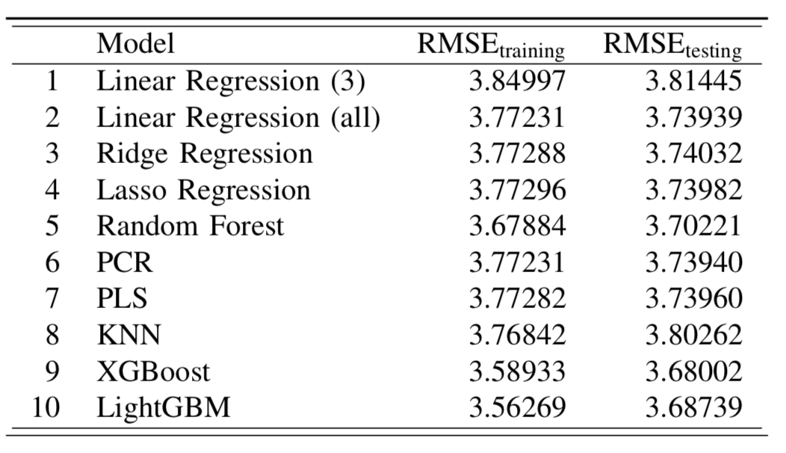
Results – RMSE Metric

Slide 11
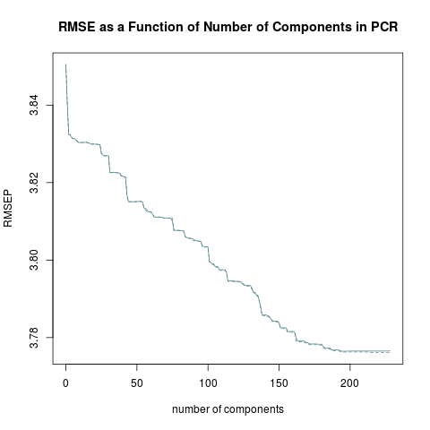
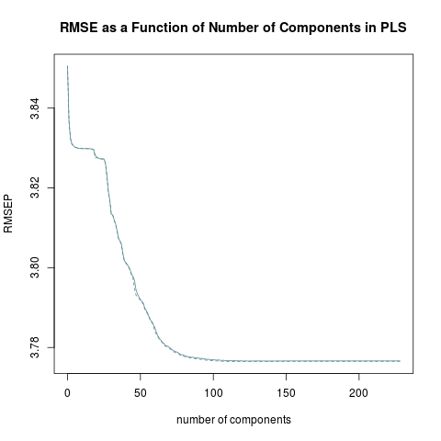
Results – Principal Components

Slide 12
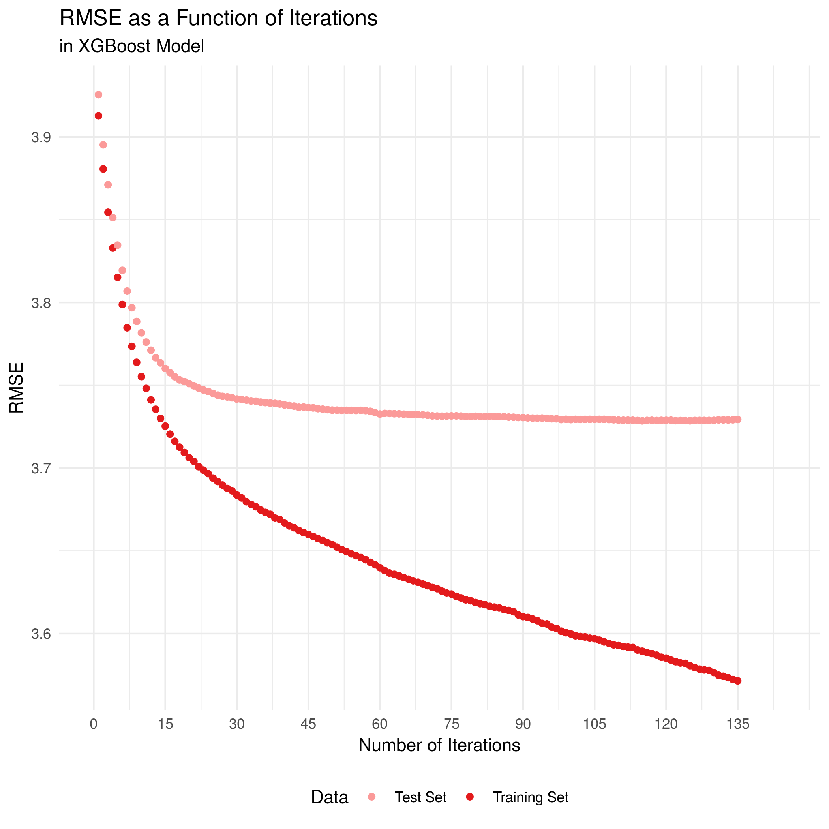
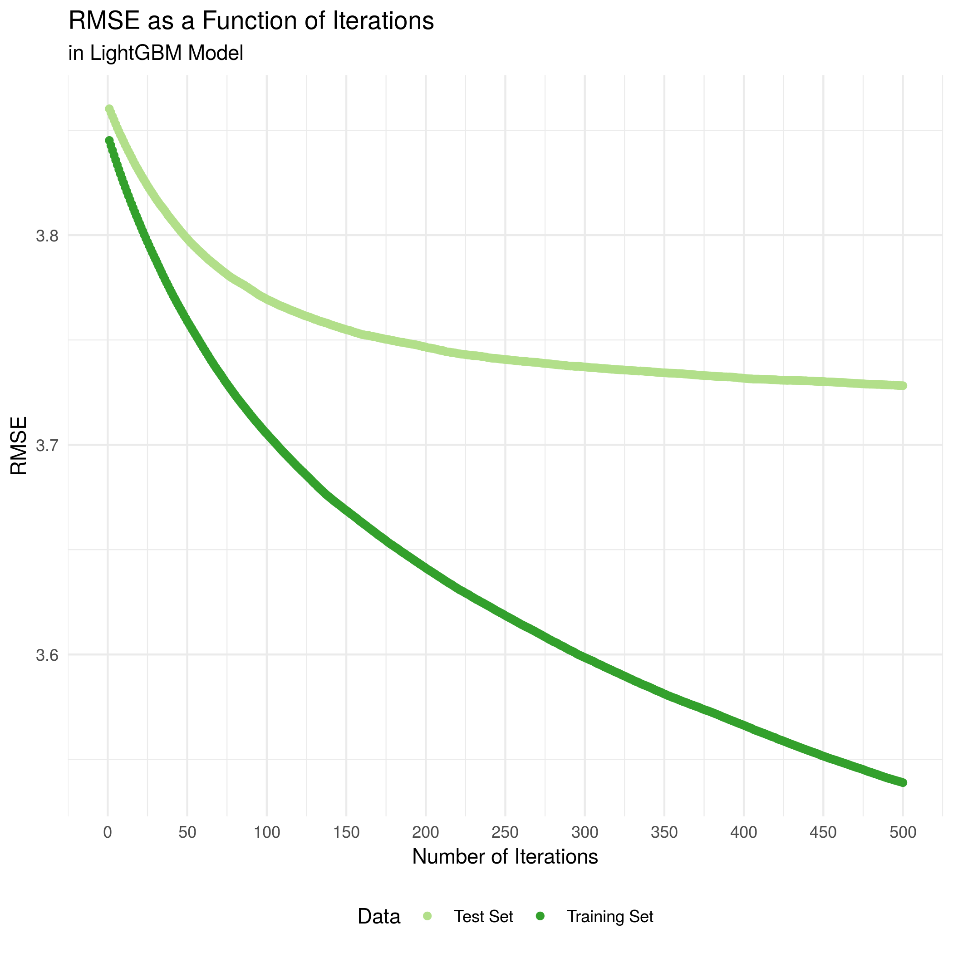
RESULTS – XGBOOST VS LIGHTGBM - RMSE

Slide 13
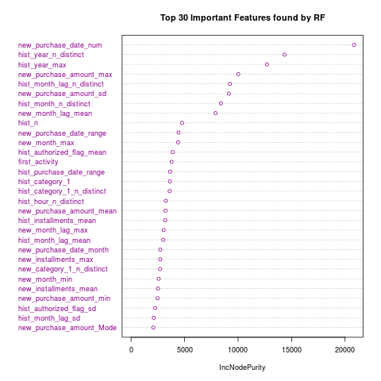
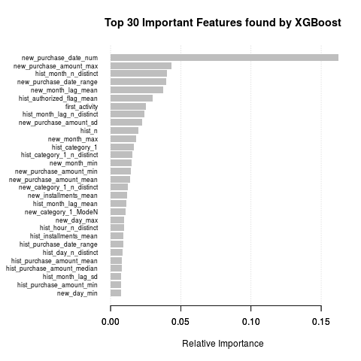
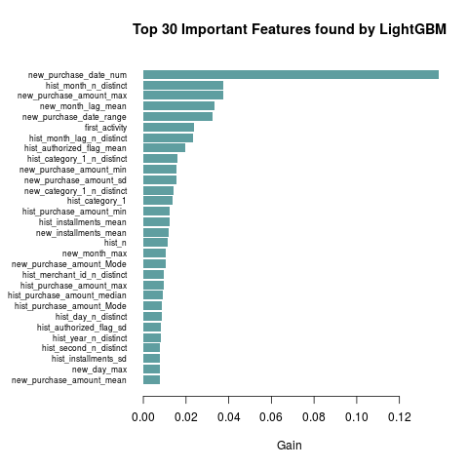
Results – Important Features

Slide 14
CONCLUSION
The gradient boosted algorithms provided the best predictability power in finding loyalty score
Further considerations in modeling include incorporating some sort of feature engineering technique to make sure of the given feature values by Elo in the training and test data

Slide 15
Any Questions?

